Slide 1
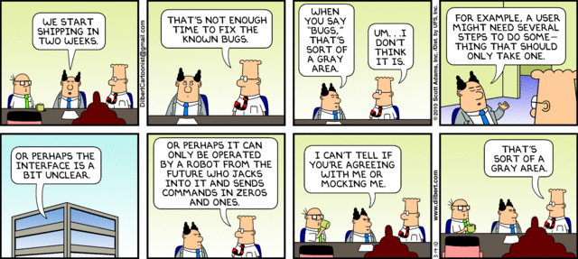
Software Engineering
Lecture 7 – Quality Attributes & Unit testing
Usability testing of fruit

Slide 2
Unit Testing
Teacher: Josef Hallberg

Slide 3
This lecture
What is unit-testing?
Why unit-test?
How much do we test?
Code example

Slide 4
Black-box testing
getRectangleArea(5,4)
public int getRectangleArea( int height, int width) { }
20
We are testing if actual output matches expected output
The test passes for getRectangleArea(5,4) = 20, and fails if not
… requirements
Black box
Actual output
compared with
required output

Slide 5
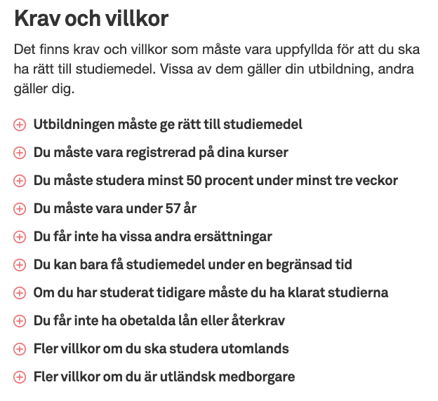
Från CSN sidan

Slide 6
Motivation
Best practices for coding:
Compile and test often
Test all branches
Don’t reintroduce old bugs
Fulfill requirements
Deliver working code

Slide 7
Why test everything?
Multiple developers
May work on different versions
Old bugs may reappear
Changing in one place
May introduce a bug somewhere else
May change the behaviour without you knowing
Unpredictable behaviour
You might have simply made an error

Slide 8
How much should we test?
As much as possible…

Slide 9
Testing Ranges: Elementary Cases
within range
2. at the boundaries
of the range
3. outside the range
(“illegal”)
range
Minimize what you need to test
or you will never stop testing!

Slide 10
Covering Every Statement is Not Sufficient
Code attempt to implement flowchart
if ( (u>1) && (v==0) ) (1)
x = x/u; (2)
if ( (u==2) || (x>3) ) (3)
++x; (4)
u=2, v=0 and x=3
executes every line (1) - (4)
gives the correct output x= 2.5
However, line (3) is wrong
What happens if u=3?
u>1 and
v==0
Yes
x = x/u
No
u==2 or
x>0
Yes
++x
No

Slide 11
Example: Legal age for purchasing alcohol
People younger than 18 may not buy alcohol
People between 18 and 20 may buy alcohol at the supermarket (3.5%), and any alcohol at a restaurant
People 20 years and older may buy alcohol at Systembolaget

Slide 12
Example: Legal age for purchasing alcohol
Pseudo code
if(age < 18) { ”may not buy alcohol” }
else if(age > 18 and age < 20) {”may buy alcohol at supermarket and restaurant”}
else if(age > 20) {”may buy alcohol at Systembolaget”}
Two bugs in this code
else if(age >= 18 …
else if(age >= 20)
So, we have to test for
age < 18
age = 18
18 < age < 20
age = 20
age > 20

Slide 13
Example: Legal age for purchasing alcohol
So, we have to test for
age < 18
age = 18
18 < age < 20
age = 20
age > 20
Time-consuming approach
Run your program 5 times:
> java AllowedPurchaseAlcohol 17
> java AllowedPurchaseAlcohol 18
> java AllowedPurchaseAlcohol 19
> java AllowedPurchaseAlcohol 20
> java AllowedPurchaseAlcohol 21

Slide 14
Unit-testing motivation
Unit-testing runs your tests automatically
Write the tests once
Test often, run in the background

Slide 15
Requirements for unit-testing
Consistency regarding input → expected output
Ability to compare output and expectation
Primitiveness (one function focuses on one thing)
Private boolean checkAvailable(x, y) {
if(rute.equals(” ”){
return true
}
return false;
}

Slide 16
Assertions
… requirements
Black box
Actual output
compared with
required output
”Assertion”
assertEquals(requirement, actual output)

Slide 17
Capture Replay Tools
Common way to automate: “GUI level macro recorders”
Scripting language – often Basic or Custom
GetEdit(), SetEdit(), ClickButton() etc.
Often give quick and easy results
Common problems:
Test maintenance
Test flakiness

Slide 18


Slide 19
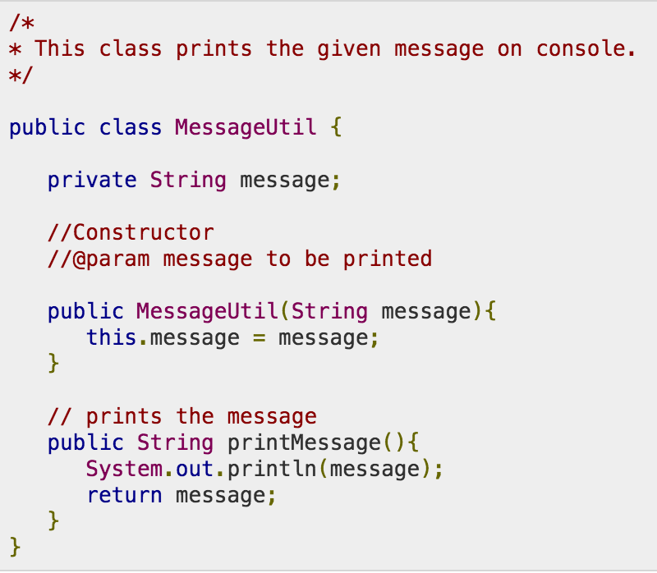
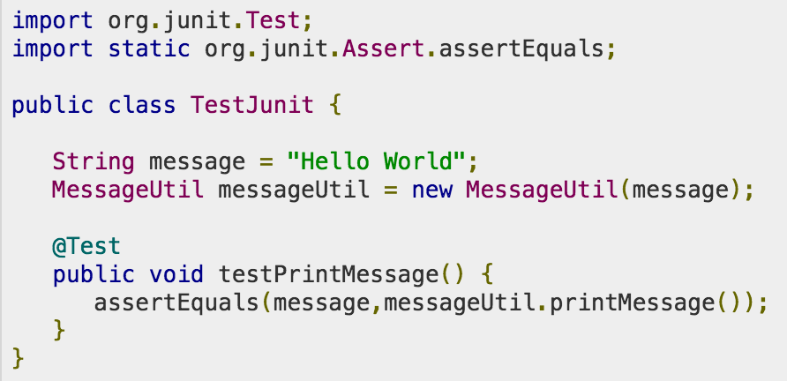
JUnit

Slide 20
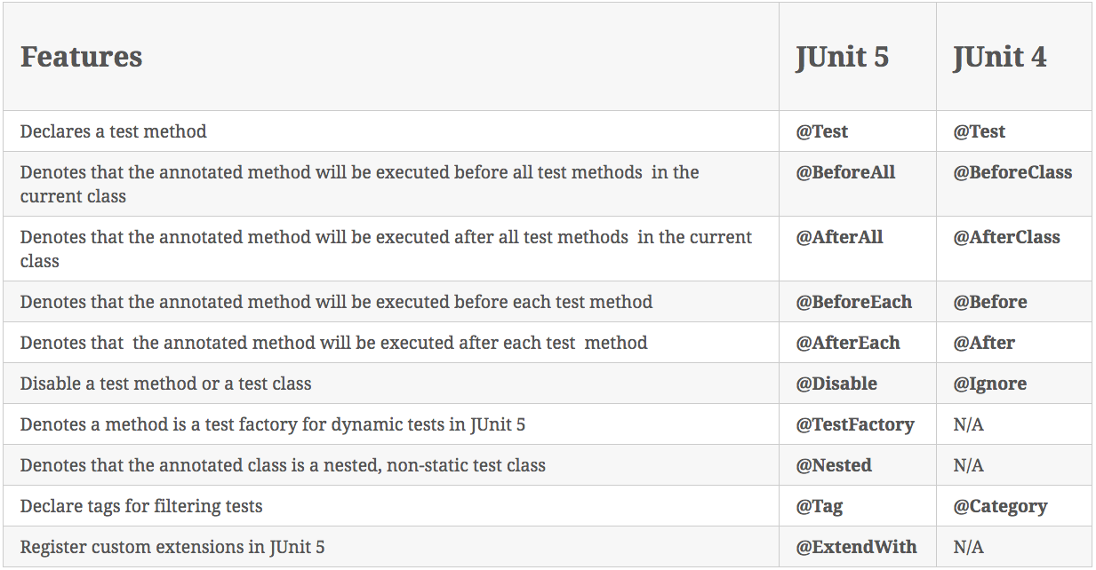
JUnit Annotations

Slide 21
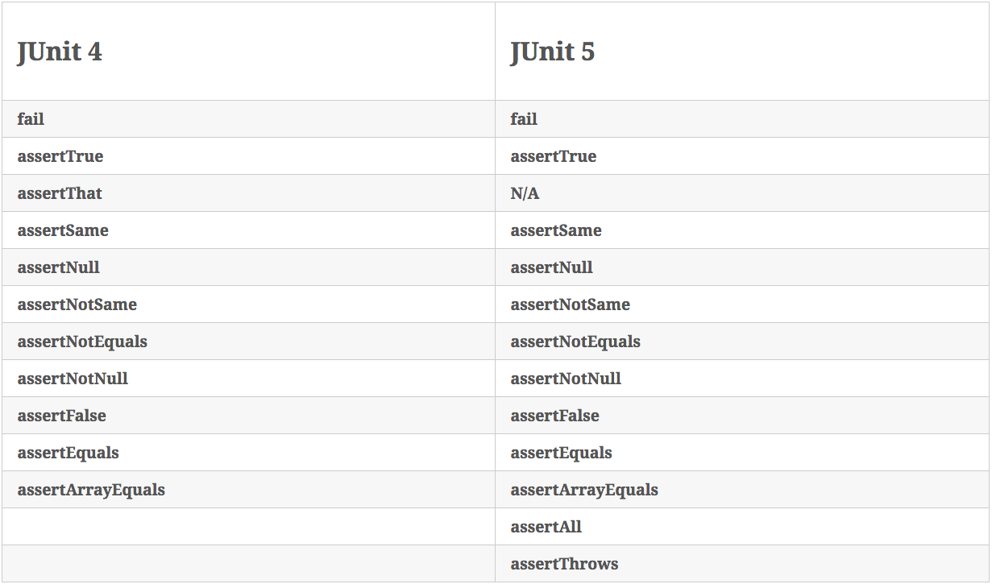
JUnit Assertions

Slide 22
assertSame / assertEquals
assertSame compares references
assertEquals runs the equals method to compare
Example: String.equals
https://docs.oracle.com/javase/9/docs/api/java/lang/String.html
If the equals method is not overriden in the classes you wish to compare, then assertSame and assertEquals work the same

Slide 23
JUnit assertion methods
…causes the current test to fail…
fail() | immediately
assertTrue(test) | if test is false
assertFalse(test) | if test is true
assertEquals(expected, actual) | if expected does not equal actual
assertSame(expected, actual) | if expected != actual
assertNotSame(expected, actual) | if expected == actual
assertNull(value) | if value is not null
assertNotNull(value) | if value is null
Can add a failure message: assertNull(“Ptr isn’t null", value)

Slide 24
Complete list of Assert
There are several variants for each assert
http://junit.sourceforge.net/javadoc/org/junit/Assert.html

Slide 25
A few general hints
Test one thing at a time per test method
10 small tests are much better than one large test
Be stingy with assert statements
The first assert that fails stops the test – provides no information about whether a later assertion would have failed
Be stingy with logic
Avoid try/catch – if it’s supposed to throw an exception, use expected= ... if not, let JUnit catch it

Slide 26
Test case dangers
Dependent test order
If running Test A before Test B gives different results from running Test B then Test A, then something is likely confusing and should be made explicit

Slide 27
JUnit and exceptions
Testing for exceptions @Test(expected = ArrayIndexOutOfBoundsException.class) public void testBadIndex() { ArrayIntList list = new ArrayIntList(); list.get(4); // this should raise the exception } // and thus the test will pass

Slide 28
Example: Legal age for purchasing alcohol
People younger than 18 may not buy alcohol
People between 18 and 20 may buy alcohol at the supermarket (3.5%), and any alcohol at a restaurant
People 20 years and older may buy alcohol at Systembolaget

Slide 29
1 out of 4 branches missed
if(age<18) {
return "may not buy alchol";
} else if(age>=18 && age<20) {
return "may buy alcohol at the supermarket and at restaurants";
} else {
return "may buy alcohol at Systembolaget";
}
Age=17 : false && true (but a different test)
Age=18 : true && true
Age=19 : true && true
Age=20 : true && false
Age= ? : false && false? (age < 18 but at the same time > 20… twilight zone)

Slide 30
Example
Is it designed for testability?
Metrics?

Slide 31
Usability
Qualitative Attribute
10 Usability Heuristics

Slide 32
Chapter Outline
What is Usability?
Usability General Scenario
Tactics for Usability
A Design Checklist for Usability
Summary

Slide 33
What is Usability?
Usability is concerned with how easy it is for the user to accomplish a desired task and the kind of user support the system provides.

Slide 34
What is Usability?
Usability comprises the following areas:
Learning system features.
Using a system efficiently.
Minimizing the impact of errors.
Adapting the system to user needs.
Increasing confidence and satisfaction.

Slide 35
Exercise
What steps should we take to ensure that our end product is usable?

Slide 36
Usability General Scenario
Portion of Scenario | Possible Values
Source | End user, possibly in a specialized role
Stimulus | End user tries to use a system efficiently, learn to use the system, minimize the impact of errors, adapt the system, or configure the system
Environment | Runtime or configuration time
Response | The system should either provide the user with the features needed or anticipate the user’s needs.
Response Measure | One or more of the following: task time, number of errors, number of tasks accomplished, user satisfaction, gain of user knowledge, ratio of successful operations to total operations, or amount of time or data lost when an error occurs.

Slide 37
Sample Concrete Usability Scenario
The user downloads a new application and is using it productively after two minutes of experimentation.

Slide 38
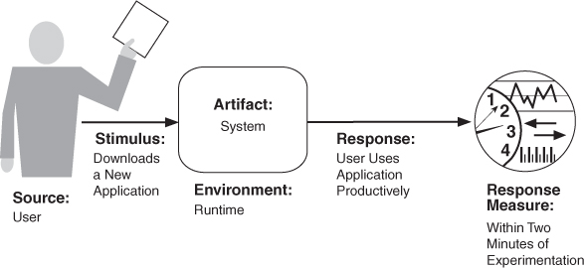
Concrete Scenario

Slide 39
Goal of Usability Tactics
Researchers in human-computer interaction have used the terms "user initiative," "system initiative," and "mixed initiative" to describe which of the human-computer pair takes the initiative in performing certain actions and how the interaction proceeds.
Usability scenarios can combine initiatives from both perspectives.
We use this distinction between user and system initiative to discuss the tactics that the architect uses to achieve the various scenarios.

Slide 40
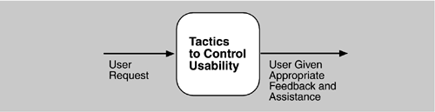
Goal of Usability Tactics

Slide 41
Question
How do we design for usability?

Slide 42
Usability Tactics

Slide 43
Support User Initiative
Cancel: the system must listen for the cancel request; the command being canceled must be terminated; resources used must be freed; and collaborating components must be informed.
Pause/Resume: temporarily free resources so that they may be re-allocated to other tasks.
Undo: maintain a sufficient amount of information about system state so that an earlier state may be restored, at the user’s request.
Aggregate: ability to aggregate lower-level objects into a group, so that a user operation may be applied to the group, freeing the user from the drudgery.

Slide 44
Support System Initiative
Maintain Task Model: determines context so the system can have some idea of what the user is attempting and provide assistance.
Maintain User Model: explicitly represents the user's knowledge of the system, the user's behavior in terms of expected response time, etc.
Maintain System Model: system maintains an explicit model of itself. This is used to determine expected system behavior so that appropriate feedback can be given to the user.

Slide 45
Checklist
Allocation of responsibilities
Coordination model
Data model
Mapping among architectural elements
Management of resources
Binding time decisions
Choice of technology

Slide 46
Allocation of responsibilities
Can the system help the user with
learning how to use the system
efficiently achieving the task at hand
adapting and configuring the system
recovering from user and system errors

Slide 47
Design Checklist for Usability
Allocation of Responsibilities | Ensure that additional system responsibilities have been allocated, as needed, to assist the user in learning how to use the system efficiently achieving the task at hand adapting and configuring the system recovering from user and system errors

Slide 48
Coordination model
Responsiveness and feedback
A click may start a chain of communication events between components
Cancelling or aborting long events
Timely fashion
Lots of components to be notified

Slide 49
Design Checklist for Usability
Coordination Model | Determine whether the properties of system elements’ coordination—timeliness, currency, completeness, correctness, consistency—affect how a user learns to use the system, achieves goals or completes tasks, adapts and configures the system, recovers from user and system errors, increases confidence and satisfaction. For example, can the system respond to mouse events and give semantic feedback in real time? Can long-running events be canceled in a reasonable amount of time?

Slide 50
Data model
Undo and cancel operations on data
In a timely fashion

Slide 51
Design Checklist for Usability
Data Model | Determine the major data abstractions that are involved with user-perceivable behavior. Ensure these major data abstractions, their operations, and their properties have been designed to assist the user in achieving the task at hand, adapting and configuring the system, recovering from user and system errors, learning how to use the system, and increasing satisfaction and user confidence For example, the data abstractions should be designed to support undo and cancel operations: the transaction granularity should not be so great that canceling or undoing an operation takes an excessively long time.

Slide 52
Mapping among architectural elements
What mappings should be visible to the user?
E.g. Is it important for the user to know that the remote bank server is being contacted?

Slide 53
Design Checklist for Usability
Mapping Among Architectural Elements | Determine what mapping among architectural elements is visible to the end user (for example, the extent to which the end user is aware of which services are local and which are remote). For those that are visible, determine how this affects the ways in which, or the ease with which the user will learn how to use the system, achieve the task at hand, adapt and configure the system, recover from user and system errors, and increase confidence and satisfaction.

Slide 54
Resource management
Manage resources so the user can achieve tasks
In a timely fashion
Feedback when expected
Error free behaviour

Slide 55
Design Checklist for Usability
Resource Management | Determine how the user can adapt and configure the system’s use of resources. Ensure that resource limitations under all user-controlled configurations will not make users less likely to achieve their tasks. For example, attempt to avoid configurations that would result in excessively long response times. Ensure that the level of resources will not affect the users’ ability to learn how to use the system, or decrease their level of confidence and satisfaction with the system.

Slide 56
Binding time
Make sure late-binding does not make the system more complicated to learn

Slide 57
Design Checklist for Usability
Binding Time | Determine which binding time decisions should be under user control and ensure that users can make decisions that aid in usability. For example, if the user can choose, at run-time, the system’s configuration, or its communication protocols, or its functionality via plug-ins, you need to ensure that such choices do not adversely affect the user’s ability to learn system features, use the system efficiently, minimize the impact of errors, further adapt and configure the system, or increase confidence and satisfaction.

Slide 58
Choice of technology
Is the technology user friendly?

Slide 59
Design Checklist for Usability
Choice of Technology | Ensure the chosen technologies help to achieve the usability scenarios that apply to your system. For example, do these technologies aid in the creation of on-line help, training materials, and user feedback collection. How usable are any of your chosen technologies? Ensure the chosen technologies do not adversely affect the usability of the system (in terms of learning system features, using the system efficiently, minimizing the impact of errors, or adapting/configuring the system, increase confidence and satisfaction).

Slide 60
Summary
Architectural support for usability involves both allowing the user to take the initiative in circumstances such as cancelling a long running command, undoing a completed command, and aggregating data and commands.
To predict user or system response, the system must keep a model of the user, the system, and the task.

Slide 61
Other Important Quality Attributes
Qualitative Attributes

Slide 62
Chapter Outline
Other Important Quality Attributes
Other Categories of Quality Attributes
Software Quality Attributes and System Quality Attributes
Using Standard Lists of Quality Attributes
Dealing with “X-ability”
Summary

Slide 63
Other attributes
Variability
Portability
Development Distributability
Scalability
Deployability
Mobility
Monitorability
Safety
Concept Integrity
Marketability

Slide 64
Other Important Quality Attributes
Variability: is a special form of modifiability. It refers to the ability of a system and its supporting artifacts to support the production of a set of variants that differ from each other in a preplanned fashion.
Portability: is also a special form of modifiability. Portability refers to the ease with which software that built to run on one platform can be changed to run on a different platform.
Development Distributability: is the quality of designing the software to support distributed software development.

Slide 65
Other Important Quality Attributes
Scalability: Horizontal scalability (scaling out) refers to adding more resources to logical units such as adding another server to a cluster. Vertical scalability (scaling up) refers to adding more resources to a physical unit such as adding more memory to a computer.
Deployability: is concerned with how an executable arrives at a host platform and how it is invoked.
Mobility: deals with the problems of movement and affordances of a platform (e.g. size, type of display, type of input devices, availability and volume of bandwidth, and battery life).

Slide 66
Other Important Quality Attributes
Monitorability: deals with the ability of the operations staff to monitor the system while it is executing.
Safety: Software safety is about the software’s ability to avoid entering states that cause or lead to damage, injury, or loss of life, and to recover and limit the damage when it does enter into bad states. The architectural concerns with safety are almost identical with those for availability (i.e. preventing, detecting, and recovering from failures).

Slide 67
Other Categories of Quality Attributes
Conceptual Integrity: refers to consistency in the design of the architecture. It contributes to the understandability of the architecture. Conceptual integrity demands that the same thing is done in the same way through the architecture.
Marketability: Some systems are marketed by their architectures, and these architectures sometimes carry a meaning all their own, independent of what other quality attributes they bring to the system (e.g. service-oriented or cloud-based).

Slide 68
Other Categories of Quality Attributes
Quality in Use: qualities that pertain to the use of the system by various stakeholders. For example
Effectiveness: a measure whether the system is correct
Efficiency: the effort and time required to develop a system
Freedom from risk: degree to which a product or system affects economic status, human life, health, or the environment

Slide 69
Software Quality Attributes and System Quality Attributes
Physical systems, such as aircraft or automobiles or kitchen appliances, that rely on software embedded within are designed to meet a whole other litany of quality attributes: weight, size, electric consumption, power output, pollution output, weather resistance, battery life, and on and on.
The software architecture can have a substantial effect on the system’s quality attributes.

Slide 70
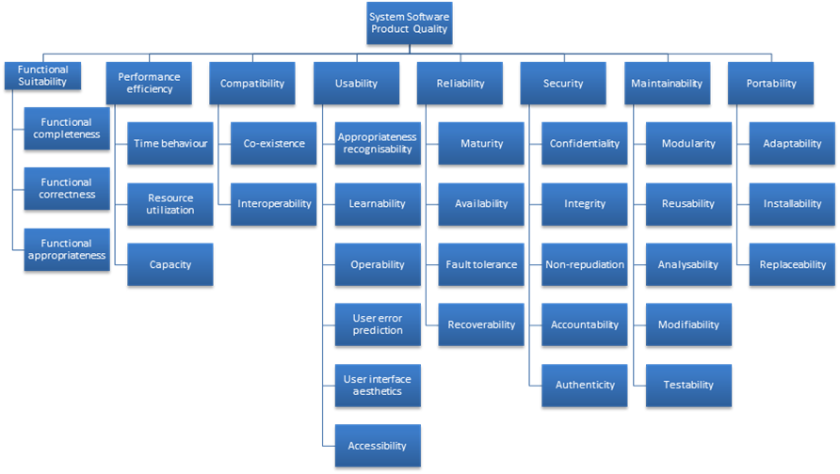
Standard Lists of Quality Attributes
ISO/IEC FCD 25010 Product Quality Standard

Slide 71
Standard Lists of Quality Attributes
Advantages:
Helpful checklists to assist requirements gathering
Ensuring that no important needs were overlooked.
Serve as basis for creating your own checklist
quality attributes of concern in your domain, your industry, your organization, your products, …

Slide 72
Standard Lists of Quality Attributes
Disadvantages:
No list will ever be complete.
Lists often generate more controversy than understanding.
Many quality attributes to take into consideration

Slide 73
Dealing with “X-ability”
What about new areas?, e.g. green computing.
What do you do?
Model the quality attribute
Assemble a set of tactics for the quality attribute
Construct design checklists

Slide 74
Summary
There are many other quality attributes than the seven that we cover in detail.
Taxonomies of attributes may offer some help, but their disadvantages often outweigh their advantages.
You may need to design or analyze a system for a “new” quality attribute. While this may be challenging, it is doable.

